Slide 1
Understanding requirements: Behavoural model and Flow model
PART-2

Slide 2
contents
Behavoural model
Activity diagram
Elements of activity diagram
Examples of activity diagram
Sequence diagram
Elements of sequence diagram
Examples of sequence diagram
Flow model
DFD
Data dictionary

Slide 3
Activity diagram
Activity Diagrams to illustrate the flow of control in a system and refer to the steps involved in the execution of a use case.
An activity diagram focuses on condition of flow and the sequence in which it happens.
Activity diagrams describe the workflow behavior of a system.

Slide 4
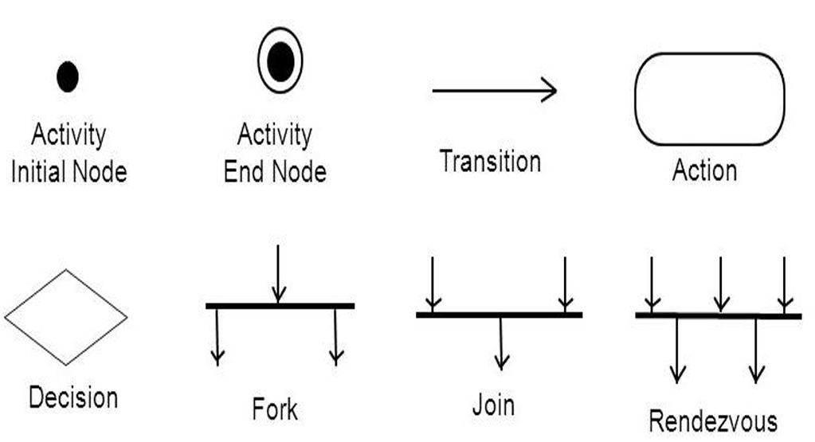
Elements of activity diagram

Slide 5
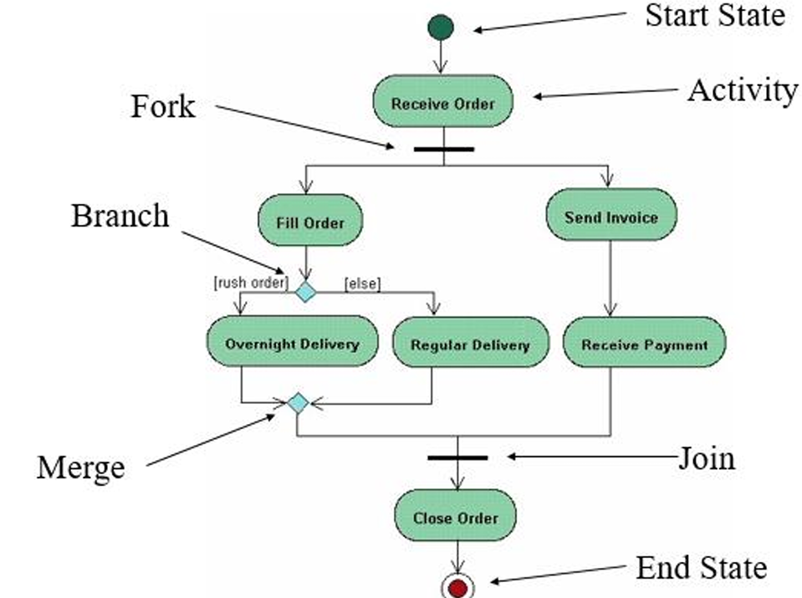
Example 1

Slide 6
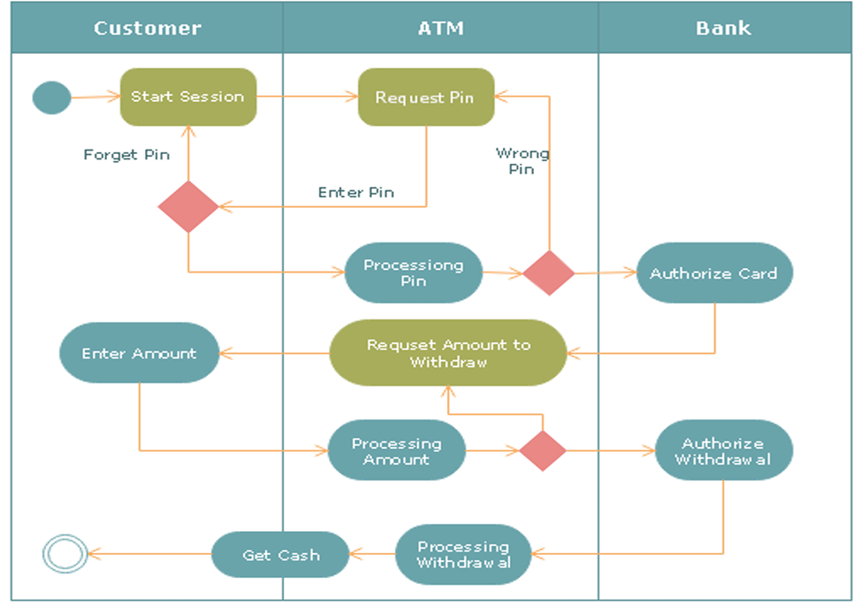
Example 2

Slide 7
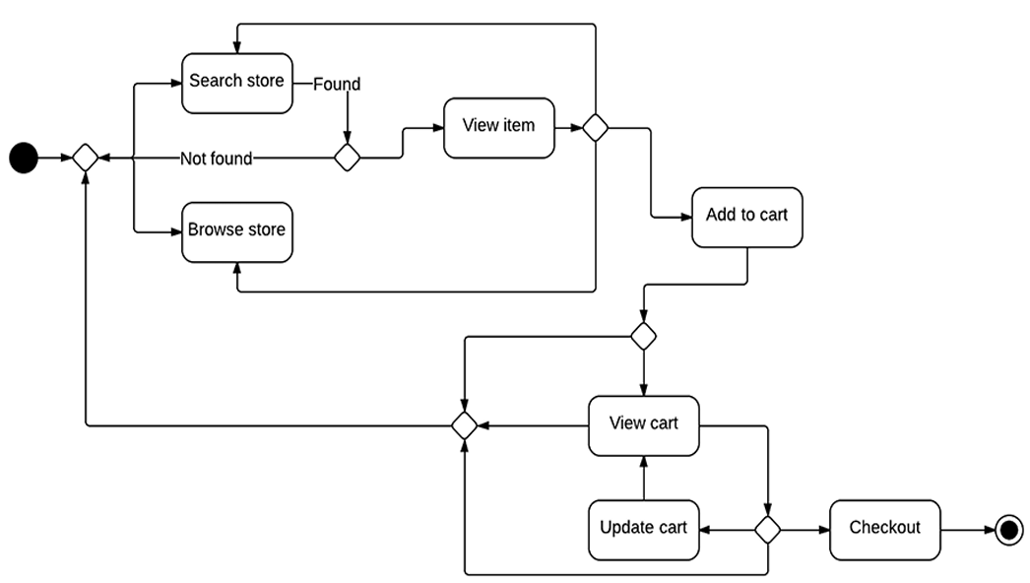
Example 3

Slide 8
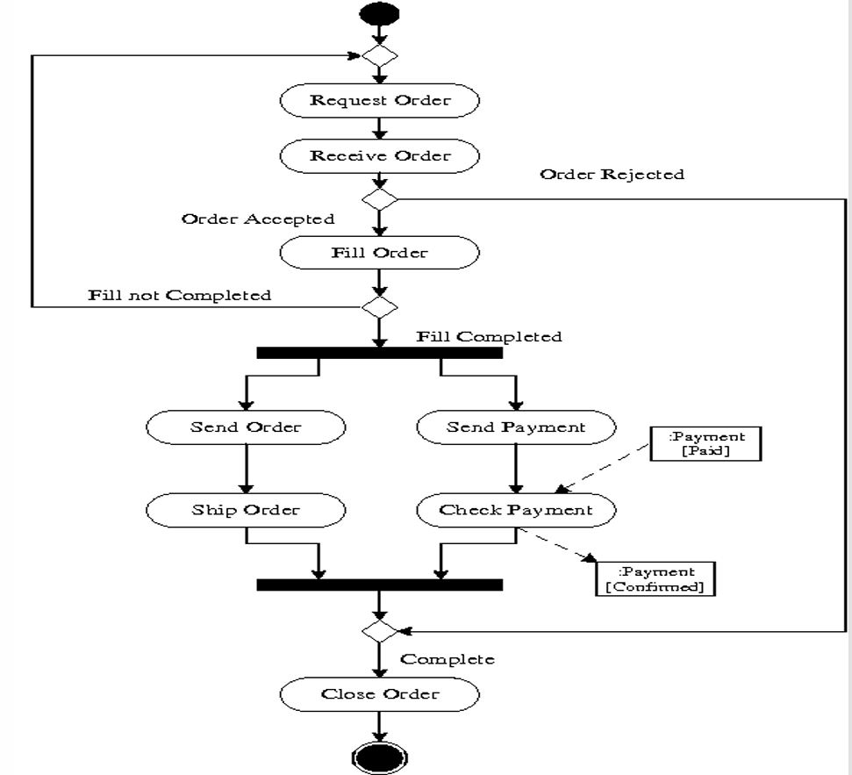
Example 4

Slide 9
Sequence Diagram
A sequence diagram describes an interaction among a set of objects participated in a collaboration (or scenario), arranged in a chronological order.
It shows the objects participating in the interaction by their "lifelines" and the messages that they send to each other.
Sequence diagrams can be useful references for businesses and other organizations.

Slide 10
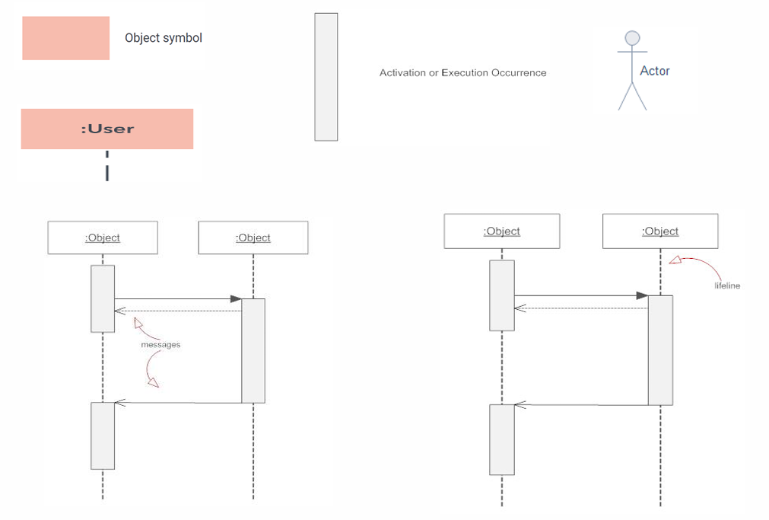
Basic Sequence Diagram Notations

Slide 11
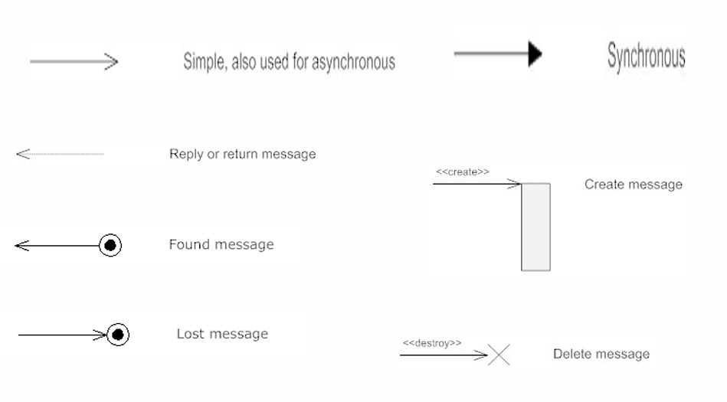
Types of messages in Sequence Diagrams

Slide 12
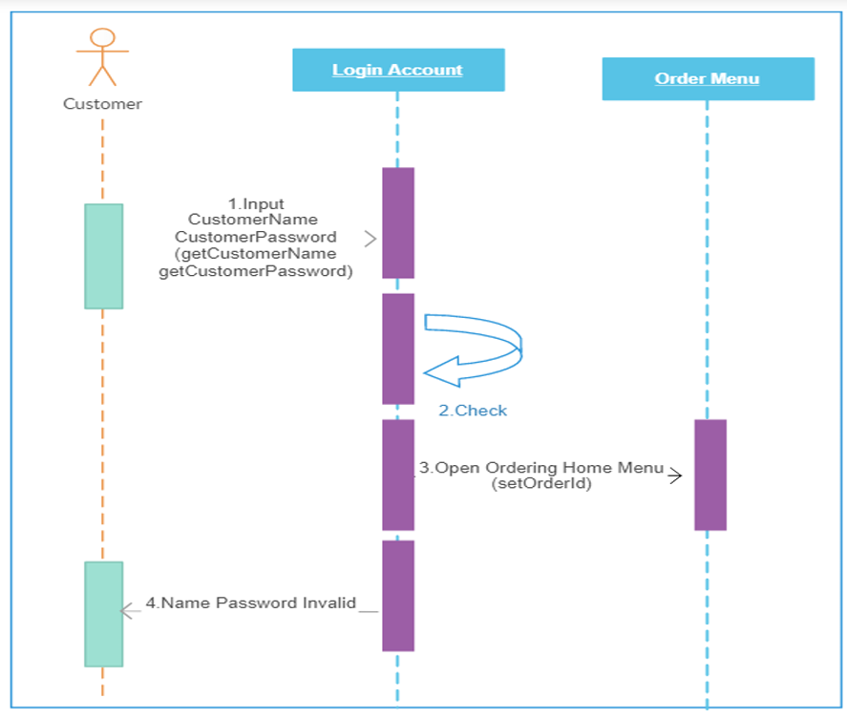
Sequence Diagram for login

Slide 13
Example 2: Sequence Diagram for ATM machine
An ATM allows patrons to access their bank accounts through a completely automated process. You can examine the steps of this process in a manageable way by drawing or viewing a sequence diagram. The example below outlines the sequential order of the interactions in the ATM system. Just click to edit the template, and customize the sequence diagram so it suits your own needs.

Slide 14
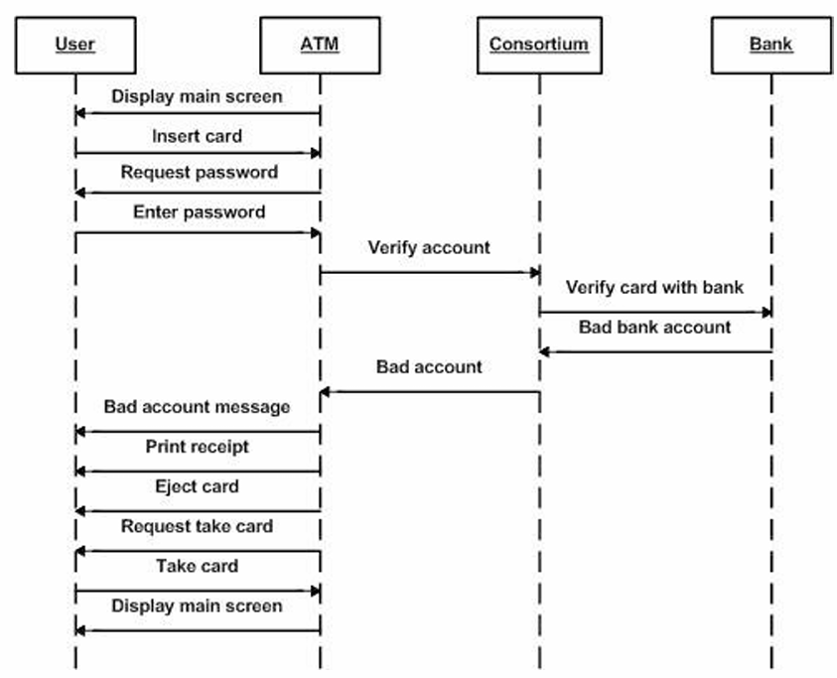
Contd.

Slide 15
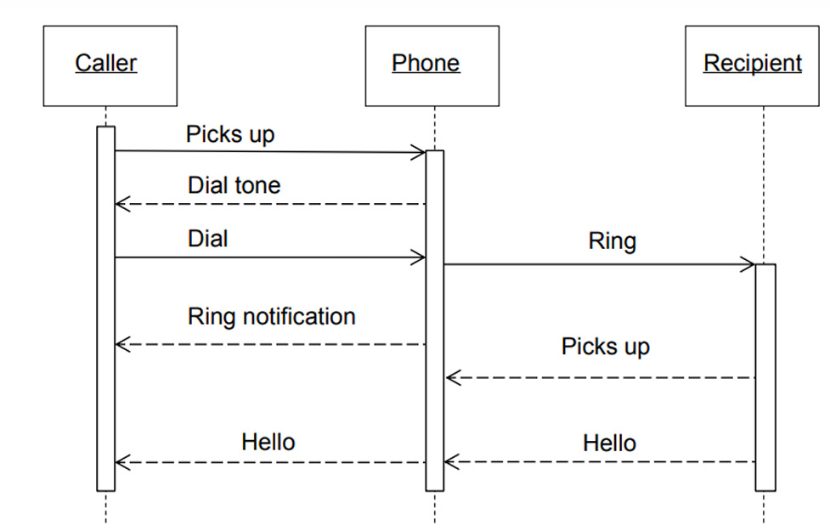
Example 3: Make a phone call

Slide 16
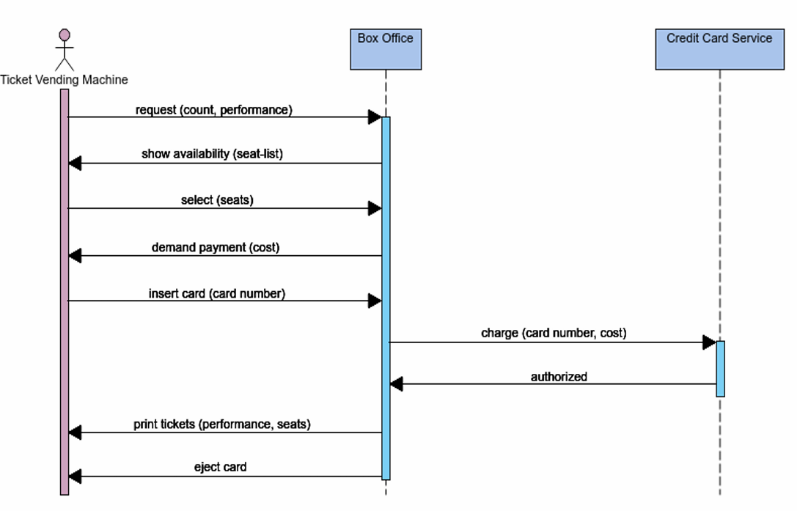
Example 4: Buy tickets

Slide 17
Example 5: Sequence diagram for hospital management system
Technology has completely transformed the field of medicine, as it has with most industries. A hospital information system, also known as a hospital information system, helps doctors, administrators, and hospital staff managing all of the activities and information collected at a hospital, including checkups, prescriptions, appointments, and information on the patients and their caretakers. The diagram below provides a simple view of how the primary processes operate with each other over time. You can use Laucidchart to reshape the diagram any way you choose and to share it with your colleagues or collaborators.

Slide 18
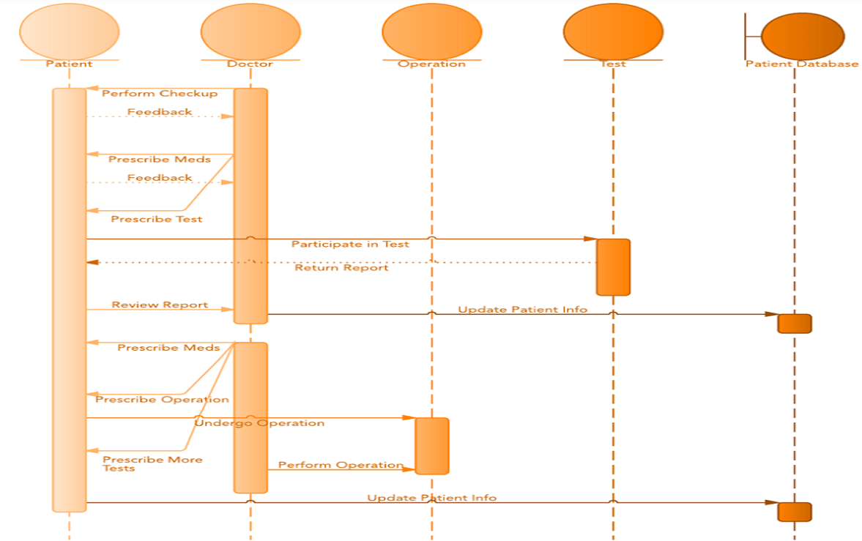
Contd.

Slide 19
Data flow diagram (DFD)
The DFD is a graphical representation of a system that shows the inputs to the system, the processing upon the inputs, the outputs of the system as well as the internal data stores.
DFDs illustrate the series of transformations or computations performed on the objects or the system, and the external controls and objects that affect the transformation.

Slide 20
The Flow Model
Every computer-based system is an information transform ....
computer
based
system
input
output

Slide 21
DFD (contd.)
The four main parts of a DFD are −
External entity
Process,
Data Flow, and
Data Stores.
The other parts of a DFD are −
Constraints, and
Control Flows.

Slide 22
Flow Modeling Notation
external entity
process
data flow
data store

Slide 23
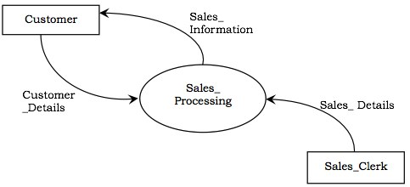
External entity/Actor
Actors are the active objects that interact with the system by either producing data and inputting them to the system, or consuming data produced by the system. In other words, actors serve as the sources and the sinks of data.
Representation in DFD − An actor is represented by a rectangle. Actors are connected to the inputs and outputs and lie on the boundary of the DFD.
Example − The following figure shows the actors, namely, Customer and Sales_Clerk in a counter sales system.

Slide 24
Contd…
A producer or consumer of data
Examples: a person, a device, a sensor
Another example: computer-based
system
Data must always originate somewhere
and must always be sent to something

Slide 25
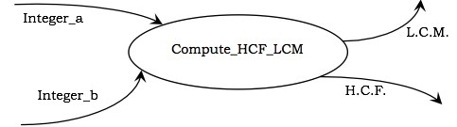
Process
Processes are the computational activities that transform data values. A whole system can be visualized as a high-level process. A process may be further divided into smaller components. The lowest-level process may be a simple function.
Representation in DFD − A process is represented as an ellipse with its name written inside it and contains a fixed number of input and output data values.
Example − The following figure shows a process Compute_HCF_LCM that accepts two integers as inputs and outputs their HCF (highest common factor) and LCM (least common multiple).

Slide 26
Contd…
A data transformer (changes input
to output)
Examples: compute taxes, determine area,
format report, display graph
Data must always be processed in some
way to achieve system function

Slide 27
Data flow
Data flow represents the flow of data between two processes. It could be between an actor and a process, or between a data store and a process. A data flow denotes the value of a data item at some point of the computation. This value is not changed by the data flow.
Representation in DFD − A data flow is represented by a directed arc or an arrow, labelled with the name of the data item that it carries.
In the above figure, Integer_a and Integer_b represent the input data flows to the process, while L.C.M. and H.C.F. are the output data flows.

Slide 28
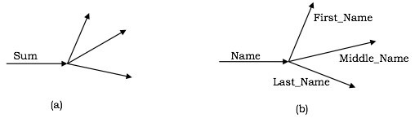
contd…
A data flow may be forked in the following cases −
The output value is sent to several places as shown in the following figure. Here, the output arrows are unlabelled as they denote the same value.
The data flow contains an aggregate value, and each of the components is sent to different places as shown in the following figure. Here, each of the forked components is labelled.

Slide 29
Contd…
Data flows through a system, beginning
as input and transformed into output.
base
compute
triangle
area
area
height

Slide 30
Data store
Data stores are the passive objects that act as a repository of data. Unlike actors, they cannot perform any operations. They are used to store data and retrieve the stored data. They represent a data structure, a disk file, or a table in a database.
Representation in DFD − A data store is represented by two parallel lines containing the name of the data store.
Each data store is connected to at least one process. Input arrows contain information to modify the contents of the data store, while output arrows contain information retrieved from the data store.
When a part of the information is to be retrieved, the output arrow is labelled. An unlabelled arrow denotes full data retrieval. A two-way arrow implies both retrieval and update.

Slide 31
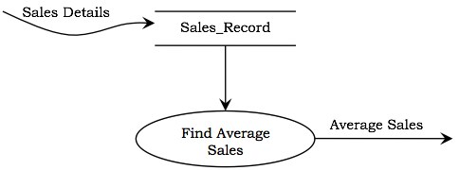
contd…
Example − The following figure shows a data store, Sales_Record, that stores the details of all sales. Input to the data store comprises of details of sales such as item, billing amount, date, etc. To find the average sales, the process retrieves the sales records and computes the average.

Slide 32
Constraints
Constraints specify the conditions or restrictions that need to be satisfied over time. They allow adding new rules or modifying existing ones. Constraints can appear in all the three models of object-oriented analysis.
It defines the restrictions on the transformations and computations.

Slide 33
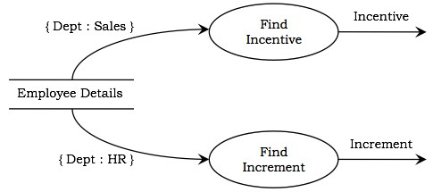
contd…
Representation − A constraint is rendered as a string within braces.
Example − The following figure shows a portion of DFD for computing the salary of employees of a company that has decided to give incentives to all employees of the sales department and increment the salary of all employees of the HR department. It can be seen that the constraint {Dept:Sales} causes incentive to be calculated only if the department is sales and the constraint {Dept:HR} causes increment to be computed only if the department is HR.

Slide 34
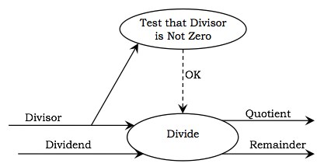
Control flows
A process may be associated with a certain Boolean value and is evaluated only if the value is true, though it is not a direct input to the process. These Boolean values are called the control flows.
Representation in DFD − Control flows are represented by a dotted arc from the process producing the Boolean value to the process controlled by them.
Example − The following figure represents a DFD for arithmetic division. The Divisor is tested for non-zero. If it is not zero, the control flow OK has a value True and subsequently the Divide process computes the Quotient and the Remainder.

Slide 35
Data Stores
Data is often stored for later use.
sensor #
sensor #, type,
location, age
look-up
sensor
data
report required
type,
location, age
sensor number
sensor data

Slide 36
Data Flow Diagramming: Guidelines
all icons must be labeled with meaningful names
the DFD evolves through a number of levels of detail
always begin with a context level diagram (also called level 0)
always show external entities at level 0
always label data flow arrows
do not represent procedural logic

Slide 37
Constructing a DFD—I
review user scenarios and/or the data model to isolate data objects and use a grammatical parse to determine “operations”
determine external entities (producers and consumers of data)
create a level 0 DFD

Slide 38
Level 0 DFD Example
processing
request
user
requested
video
signal
digital
video
processor
monitor
video
source
NTSC
video signal

Slide 39
Constructing a DFD—II
write a narrative describing the transform
parse to determine next level transforms
“balance” the flow to maintain data flow continuity
develop a level 1 DFD
use a 1:5 (approx.) expansion ratio

Slide 40
The Data Flow Hierarchy
a
b
x
P
y
level 0
a
c
p2
f
p1
p4
b
d
5
p3
e
g
level 1

Slide 41
Flow Modeling Notes
each bubble is refined until it does just one thing
the expansion ratio decreases as the number of levels increase
most systems require between 3 and 7 levels for an adequate flow model
a single data flow item (arrow) may be expanded as levels increase (data dictionary provides information)

Slide 42
Process Specification (PSPEC)
bubble
PSPEC
narrative
pseudocode (PDL)
equations
tables
diagrams and/or charts

Slide 43
DFDs: A Look Ahead
analysis model
Maps into
design model

Slide 44
DFD (example)
Example − Let us consider a software system, Wholesaler Software, that automates the transactions of a wholesale shop. The shop sells in bulks and has a clientele comprising of merchants and retail shop owners. Each customer is asked to register with his/her particulars and is given a unique customer code, C_Code. Once a sale is done, the shop registers its details and sends the goods for dispatch. Each year, the shop distributes Christmas gifts to its customers, which comprise of a silver coin or a gold coin depending upon the total sales and the decision of the proprietor.

Slide 45
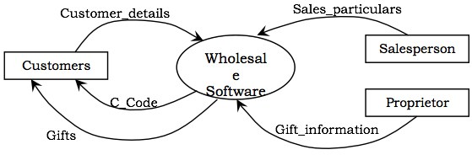
Contd.
The actors in the system are −
Customers
Salesperson
Proprietor

Slide 46
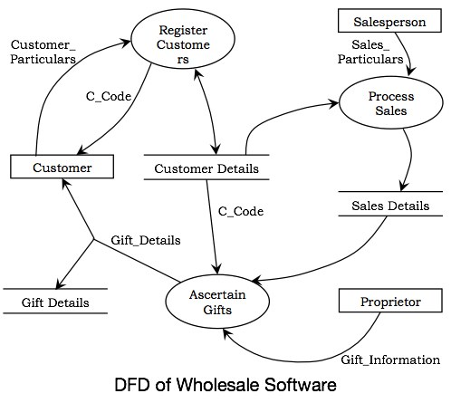
Contd.
In the system, three processes can be identified, which are −
Register Customers
Process Sales
Ascertain Gifts
The data stores that will be required are −
Customer Details
Sales Details
Gift Details

Slide 47
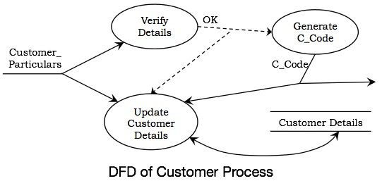
Contd.
The following figure shows the details of the process Register Customer. There are three processes in it, Verify Details, Generate C_Code, and Update Customer Details. When the details of the customer are entered, they are verified. If the data is correct, C_Code is generated and the data store Customer Details is updated.

Slide 48
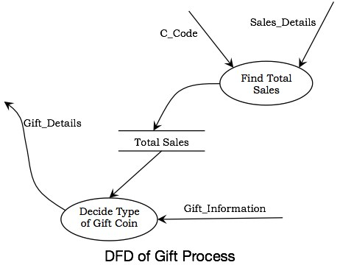
Contd.
The following figure shows the expansion of the process Ascertain Gifts. It has two processes in it, Find Total Sales and Decide Type of Gift Coin. The Find Total Sales process computes the yearly total sales corresponding to each customer and records the data. Taking this record and the decision of the proprietor as inputs, the gift coins are allotted through Decide Type of Gift Coin process.

Slide 49
Data Dictionary
A data dictionary contains metadata i.e., data about the database.
It contains information such as what is in the database, who is allowed to access it, where is the database physically stored, etc.
It plays an important role in building a database.

Slide 50
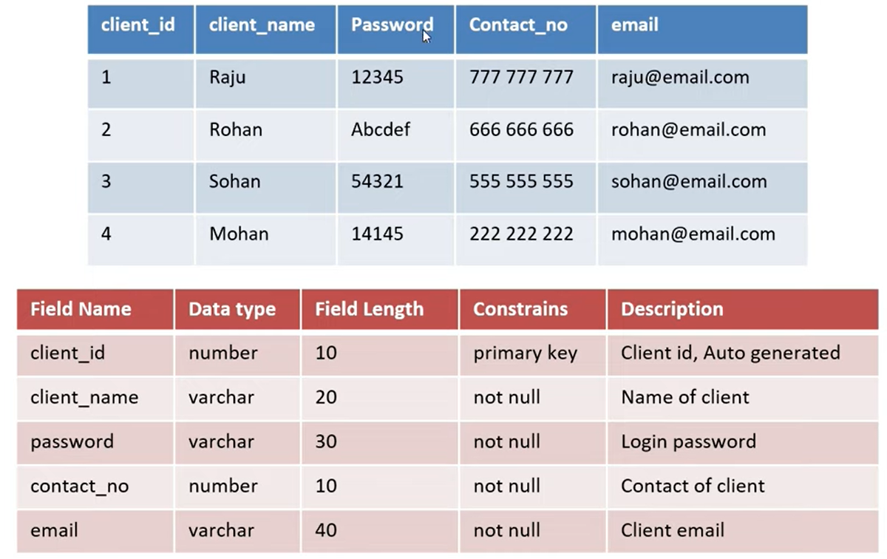

Slide 51
Contd…
The data dictionary in general contains information about the following:
Names of all tables in the database
Names of each field in the tables of the database
Constraints defined on tables
Physical information about tables like their storage location, storage method, etc.

Slide 52
Uses of Data Dictionary
Validates the DFD for completeness and accuracy
Provides starting point for developing screen and reports
Determine the contents of data stored files
Develop the logic for DFD process.

Slide 53
Advantages of data dictionary
It gives the well structured and clear information about the database.
One can analyze the requirement, any redundancy like duplicate columns, tables, etc.
It is very helpful for the administration or any new DBA to understand the database. Since it has all the information about the database, DBA can easily able to track any chaos in the database.
Since database is a very huge, and will have lots of tables, views, constraints, indexes etc., it will be difficult for anyone to remember. Data dictionary helps user by providing all the details in it.
It is a valuable reference in any organization because it provides documentation.

Slide 54
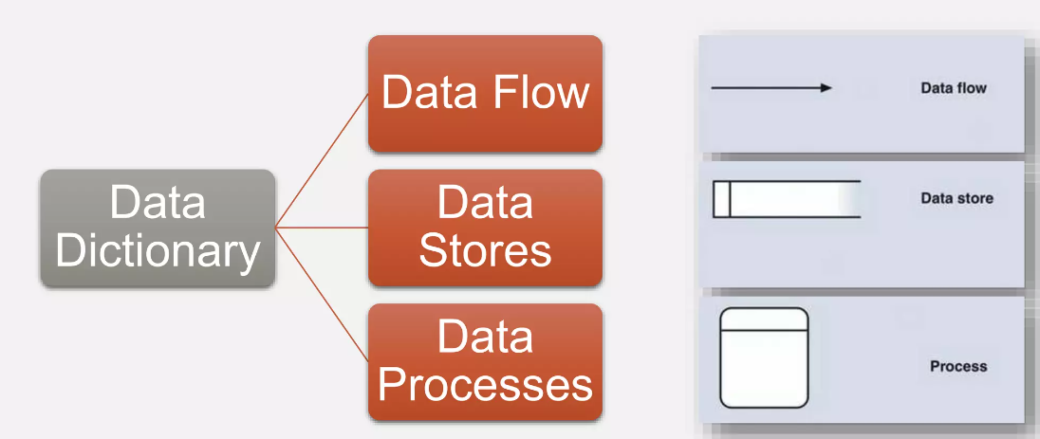
Sources of Information

Slide 55
Four categories of Data dictionary
Data flows
Data structure
Data elements
Data stores

Slide 56
Defining the data flow
Data flow is a collection of data elements
It is the first component to be defines
Elements/Fields: used to describe details of each data flow
Data structure: group of elements

Slide 57
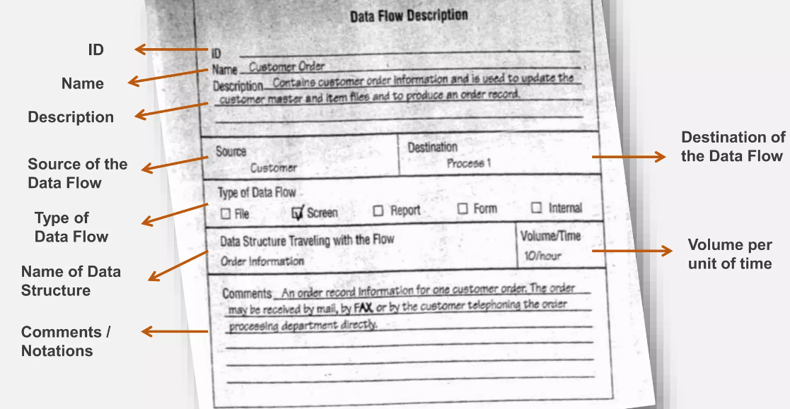

Slide 58
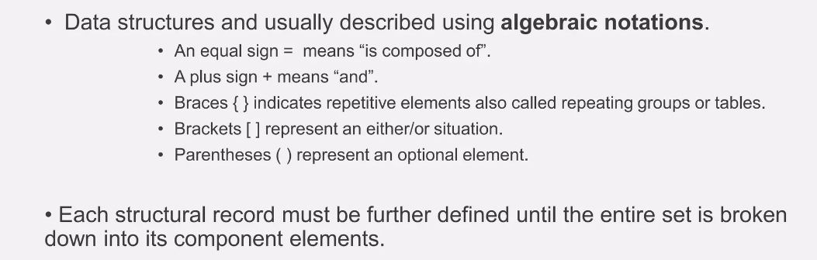
Describing data structures

Slide 59
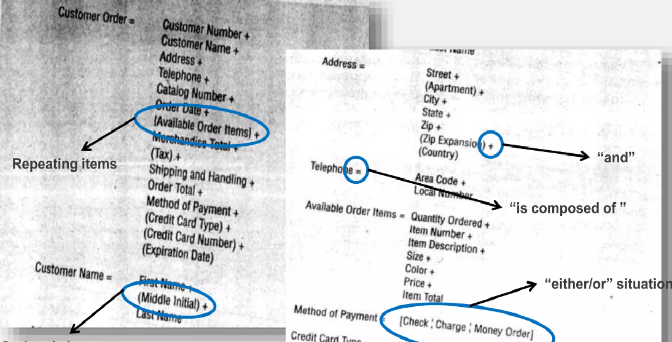

Slide 60
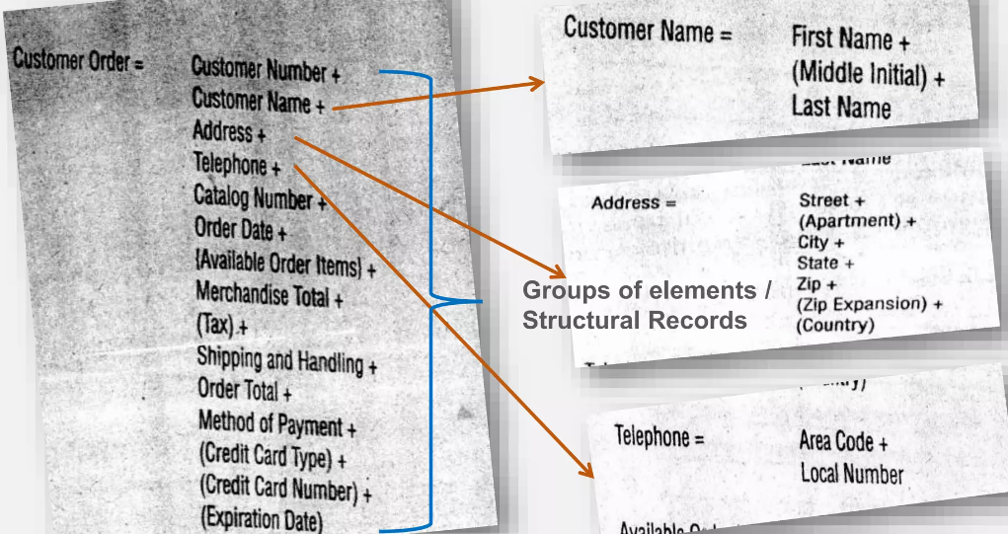

Slide 61
Data elements
Data elements definitions describe a data type.
Each element should also be defined to indicate specifically what it represents. It should be specific.

Slide 62
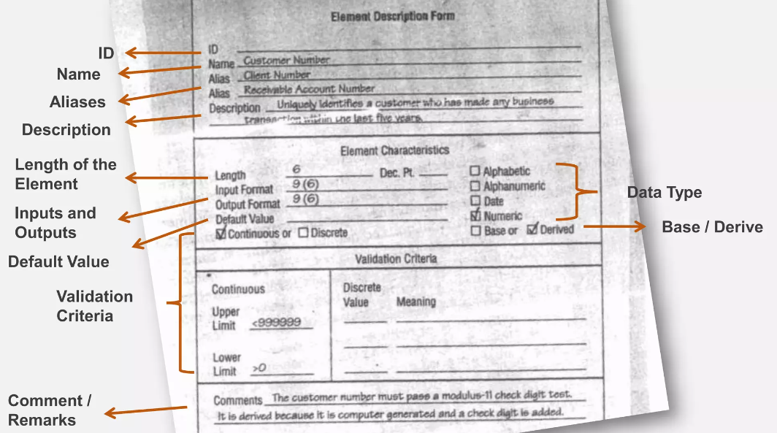

Slide 63
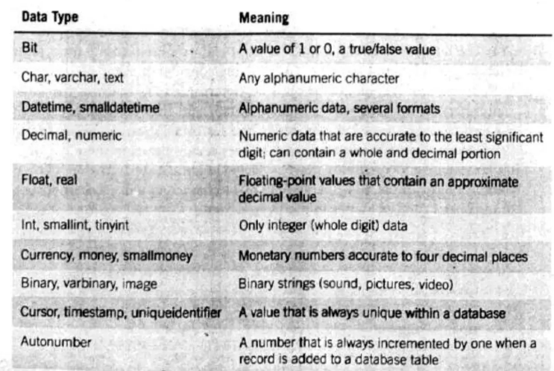

Slide 64
Data stores
Data stores are created for each different data entity being stored.

Slide 65
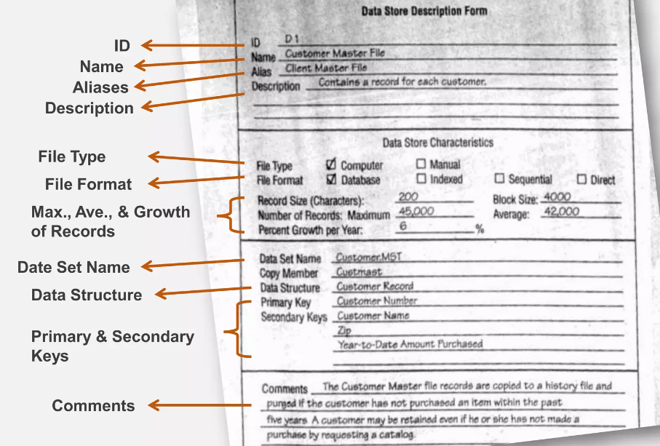

Slide 66
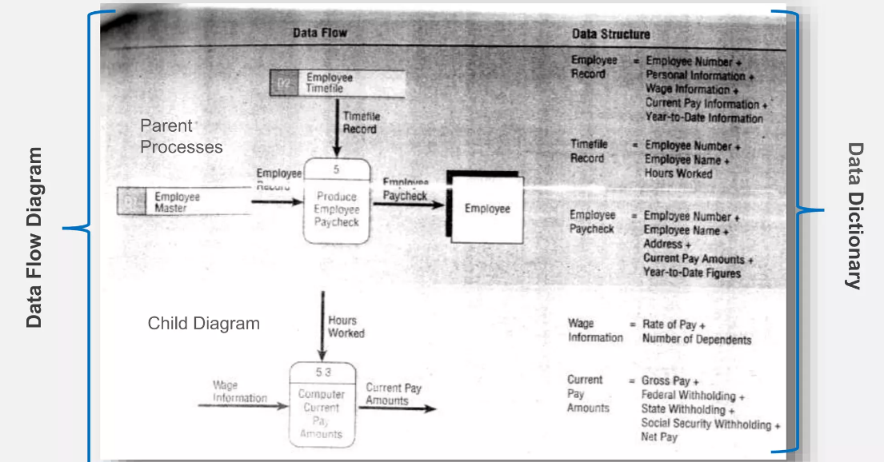
Creating data dictionary: Example

Slide 67
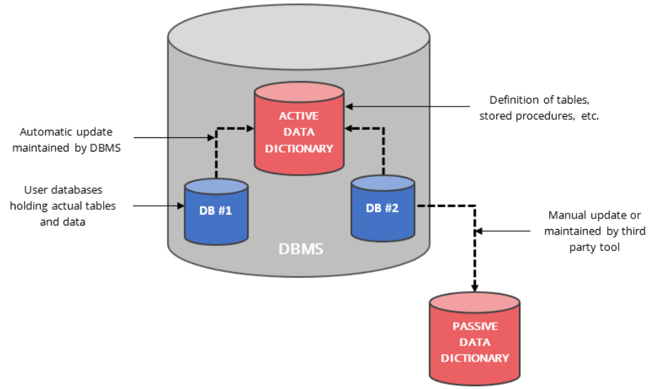
Types of data dictionary
Active
Passive

Slide 68
Active data dictionary
An active data dictionary is a type of dictionary that is very consistent and managed automatically by the DBMS.
In the active data dictionary, when any modification or changes is executed by the DBMS, then this dictionary it also gets modified by the DBMS automatically.
Any alteration or modification in the structure of the database can also be seen in the data dictionary with the help of its feature i.e, automatic updating of information by the DBMS.
In this dictionary, there is some impact on the structure of the database in the modification process or when we are changing some data in the database.
The benefit of this data dictionary is that it does not need any external maintenance software or tool and also there is no extra cost for the maintenance of the data dictionary as the database management system automatically manages this dictionary.

Slide 69
Passive data dictionary
This data dictionary also has the storage for centralizing the metadata. Also, there is no impact on the structure (means the structure can be modified) of the database in the passive data dictionary which was in the case of the active data dictionary.
One of the disadvantages of a passive data dictionary is that it does not require any dedicated software for updating or modification.
Another disadvantage of this dictionary is that it requires a lot of maintenance cost and also requires other teams to manually maintain the database and if this process is not done or handled correctly then there is a chance that the database and data dictionary gets out of sync.
Also, this data dictionary is not a choice for many users as it is not easy to maintain as an active dictionary.

Slide 70
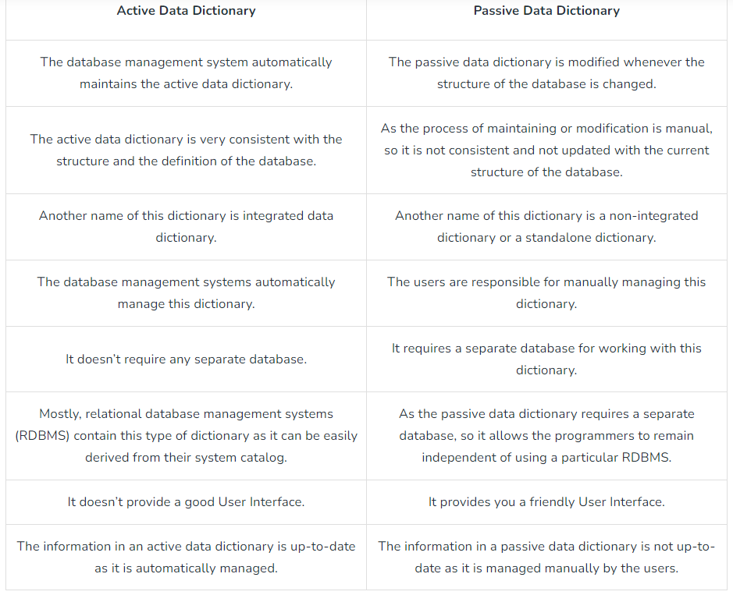
Active Vs Passive Data Dictionary

Slide 71
Thank you!!!

